Slide 1
Design Sprint

Slide 2
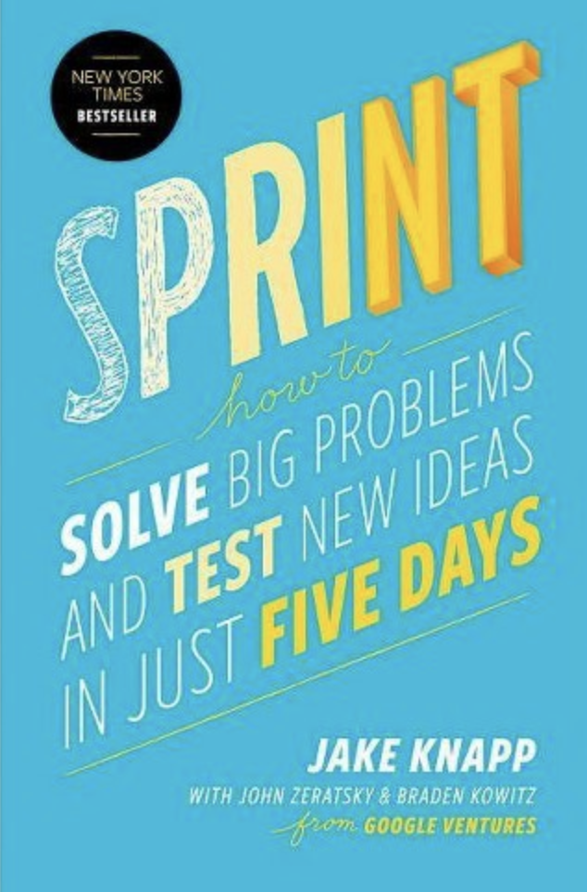
Jake Knapp is Inventor of Design Sprint
Jake spent 10 years at Google and Google Ventures, where he created the Design Sprint process

Slide 3
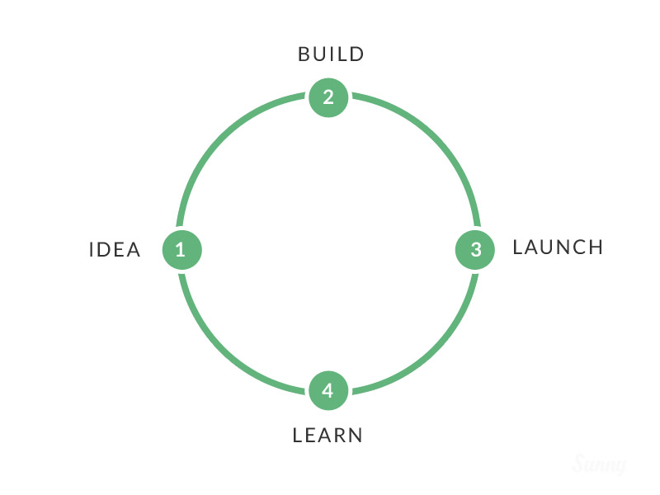

Slide 4
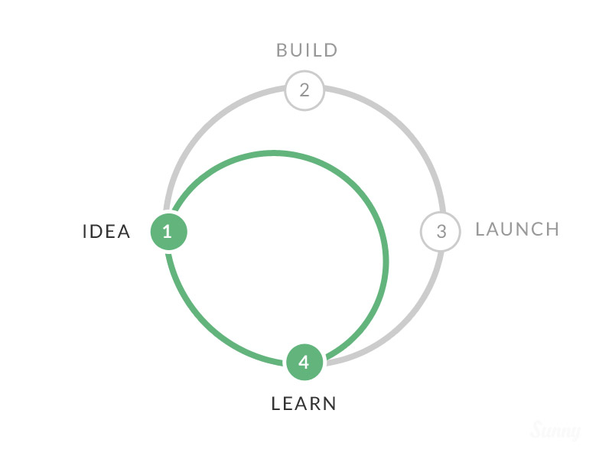

Slide 5
Design Sprint Flow
Abstract
Sketch
Prototype
Decide
Understand
Test
Only 5 Days
Concrete

Slide 6
What is Design Sprint ?
“The sprint is GV’s unique five-day process for answering crucial questions through prototyping and testing ideas with customers”

Slide 7
Rules
Working Together But Alone
Getting Started is more important than Being Right
Don’t Rely on Creativity
More / less / enough Time

Slide 8
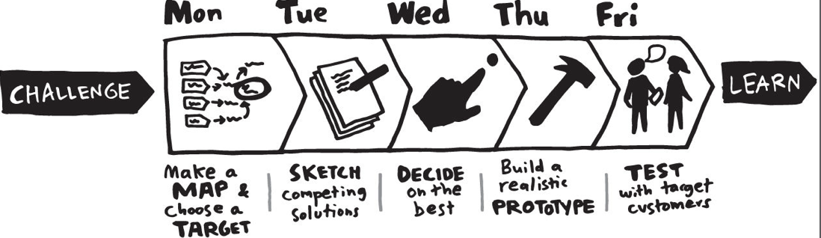
Design Sprint Process

Slide 9
Challenge
Problem : Hotel, Supermarket, dll sulit dalam melakukan pembuangan sampah. Dikarenakan jumlah sampah yang menumpuk di waktu yang tidak tentu. Dan jarak TPA cukup jauh dari tempat.
Solusi : Dapat memesan orang untuk mengambilkan sampah dan membuangnya melalui aplikasi
LongTerm Goal : Manajemen pembuangan sampah yang mudah, cepat dan terkendali SERTA MURAH

